Slide 1
Project proposal
Team number 12
Arnav Kumar
Prathamesh Koranne

Slide 2
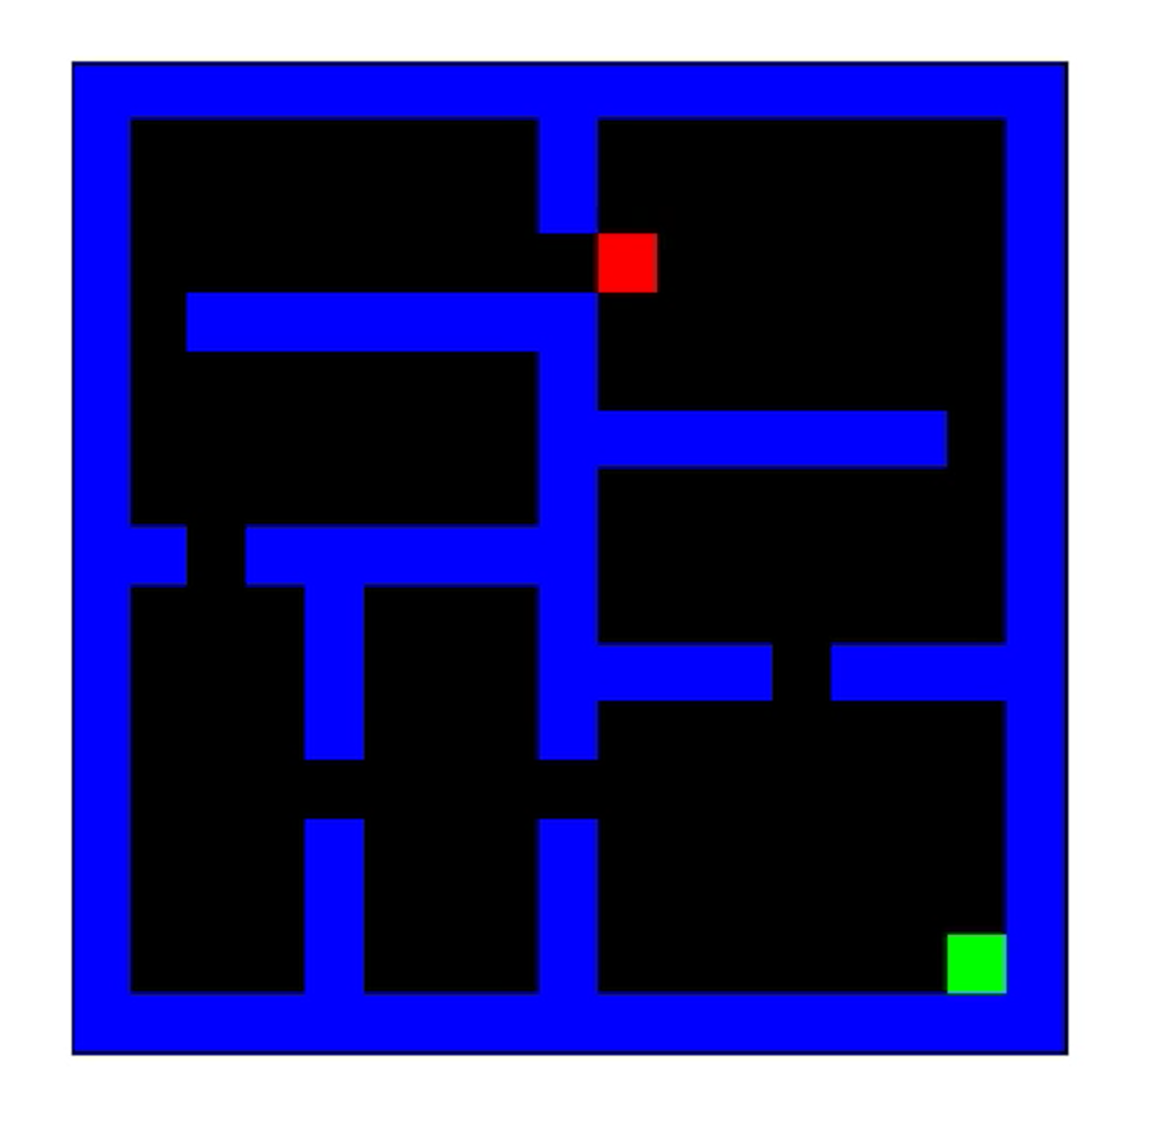
Goal
Solve 1 hard maps as defined on the GitHub repository

Slide 3
Proposed approach
Algorithm :- TD-Lambda
Heuristics:-
(modified) distance based heuristic
Strategic position based
Collisions

Slide 4
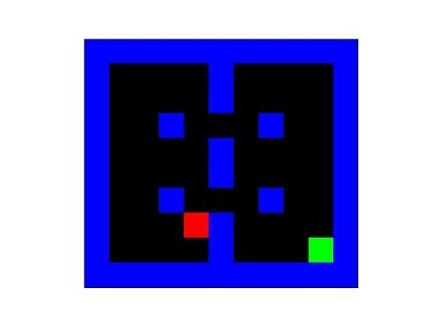
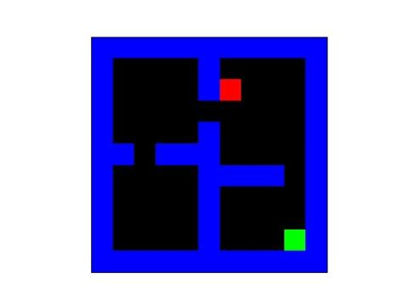
Result for Medium graphs
Medium 1
Medium 0

Slide 5
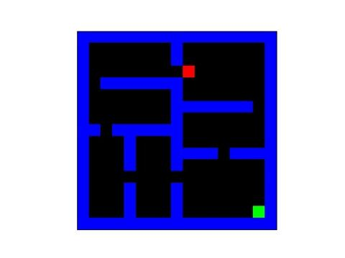
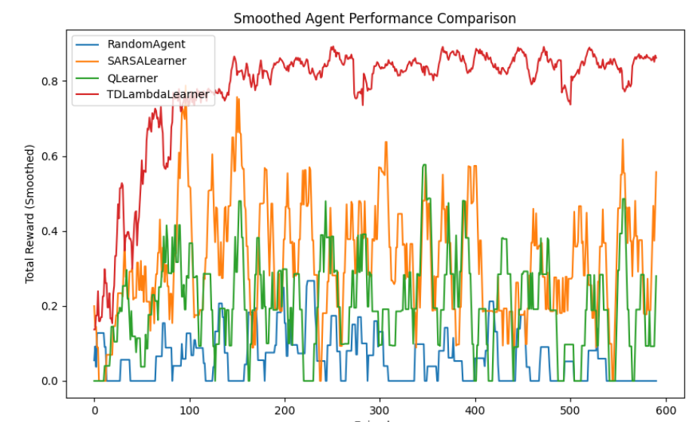
Graph and Results for Hard -0

Slide 6
Future plan and improvements
Stability and further hyper parameter tuning

